Slide 1

Celebrity Sports Twitter commentator

Slide 2

A modern sports commentator that you want
We all have our favorite writers
Someone who gives text a new breath of life
Text that when you read it, almost always makes you read it in their voice
Someone you can identify by their own literature
A person that means something to you

Slide 3
Where does it come from?
Academic Literature: Building Applied Natural Language Generation Systems – Professor Ehud Reiter & Professor Robert Dale
Perhaps the greatest paper ever written?
Novels: Harry Potter – J.K. Rowling
Text that brings you back into fantasy.
News: 'Puddle Splash Victim Vows Revenge' - Somerset Mercury Newpaper, 2013
The most honest and transparent of text!

Slide 4
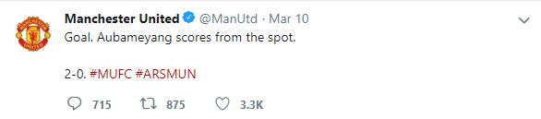

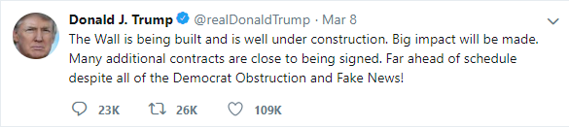
The Text of today

Slide 5
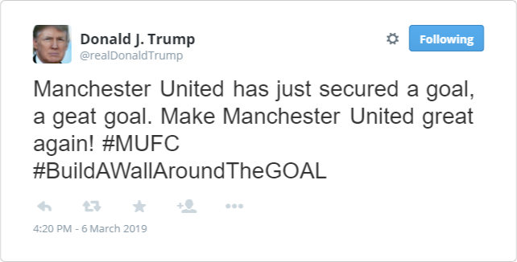
Our Vision

Slide 6
Marketing
How many people can buy our product?
How much customer have to pay for our product?
How we make money from our products?
Gambling.

Slide 7
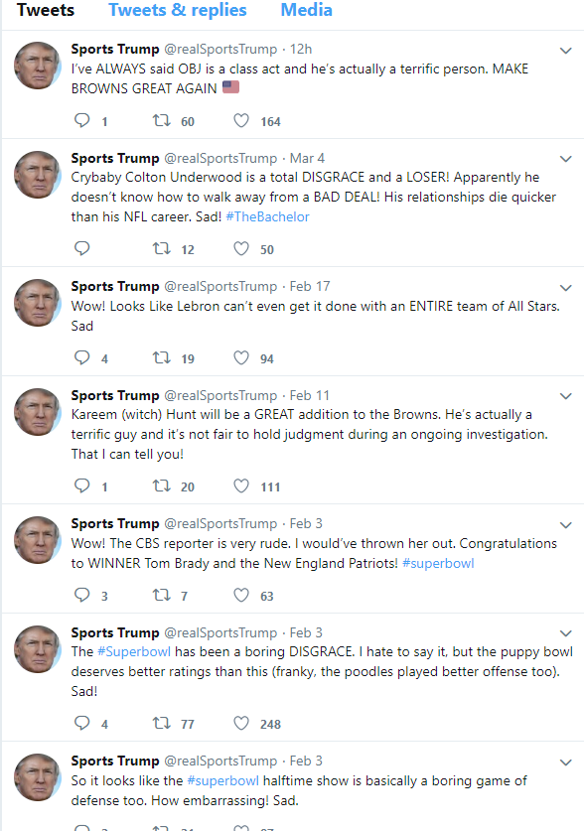
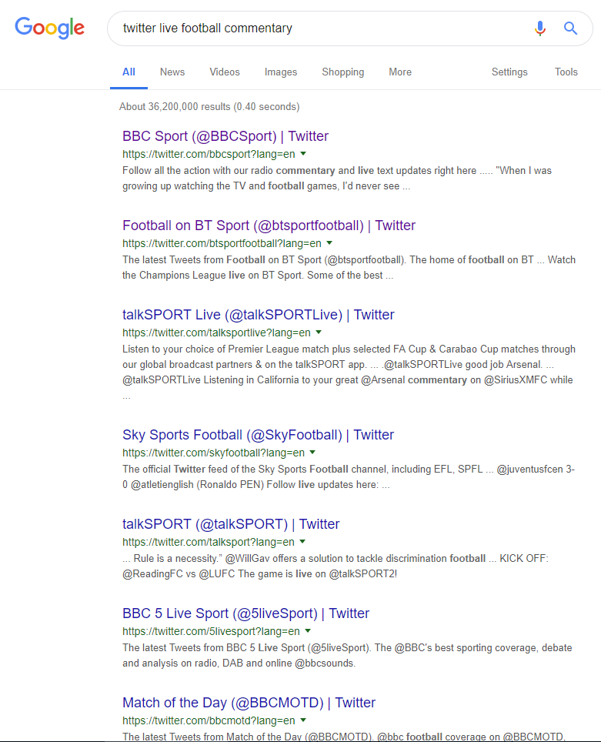
Competitors
Other live commentators
Twitter commentators
Various websites
Parody twitter accounts

Slide 8
Competitors
Don’t offer what we are offering
Only connection is football commentaries

Slide 9
COST
Several factors that need to be taken into account
Salary of developers
Location
Overhead
Marketing
Licences

Slide 10
Why will people buy this product?
The world is too serious
To be a part of something greater
To add value to the things we love
The Premier League is the most-watched sports league in the world, broadcast in 212 territories to 643 million homes and a potential TV audience of 4.7 billion people.

